Slide 1


Segmentation and characterization of nuclear structures in super-resolution microscopy images

Slide 2
Background : Microscopy technology
Microscopy technology enables capturing fine biological structures and unraveling their composition and organization. However, as image resolution increases while the sample sizes remain similar, modern microscopy imaging gives rise to large amounts of data requiring automated analysis pipelines for information extraction.

Slide 3
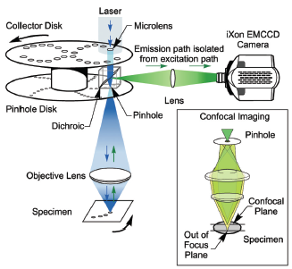
Spinning disk confocal microscopy
Spinning disk confocal microscopy utilizes multiple pinholes or slits to project a series of 1000 or more parallel excitation light beams onto the specimen in a multiplexed pattern that is subsequently detected after fluorescence emission passes through the same pinholes or slits.

Slide 4
Project goal
OUR GOAL IS TO develop analysis algorithms for the quantitative characterization of the structure of tubular nuclear envelop invaginations in embryonic cells.
Medical interest : these structures thought to play a key role in gene expression regulation during development.

Slide 5
BLOCK DIAGRAM
Characterization of the structure of tubular nuclear envelop invaginations in embryonic cells
DENOISING
IMAGE PROCESSING
SEGMENTATION OF THE TUNNELS
IMAGE PROCESSING
SEGMENTATION OF THE CELLS
MORPHOLOGICAL FEATURES as shape, structure, size of cells

Slide 6
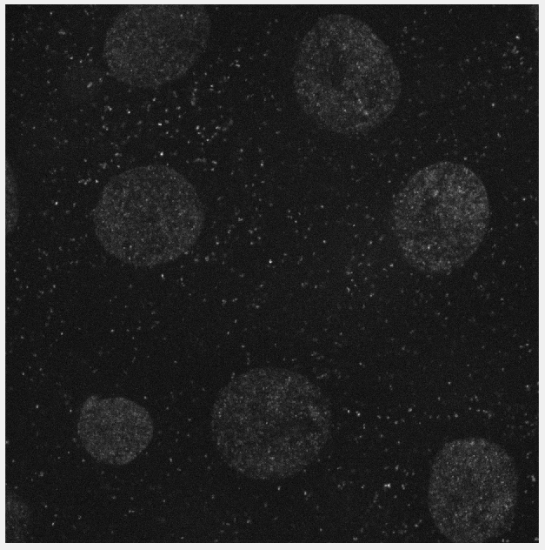
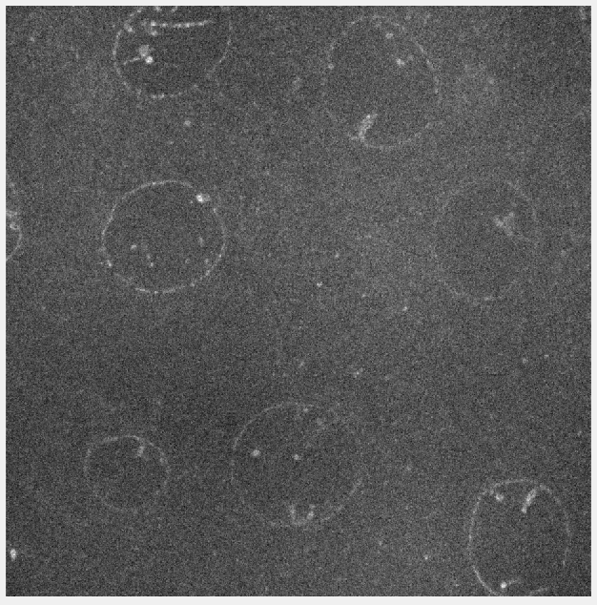
TWO CHANNELs

Slide 7
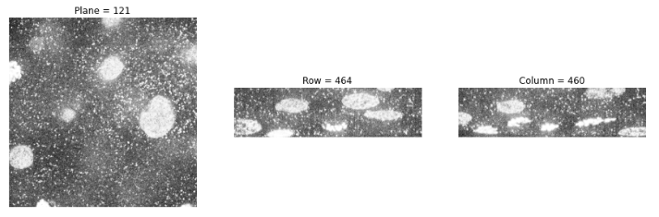
CHANNEL ONE : 3D visualization NEW ONE

Slide 8
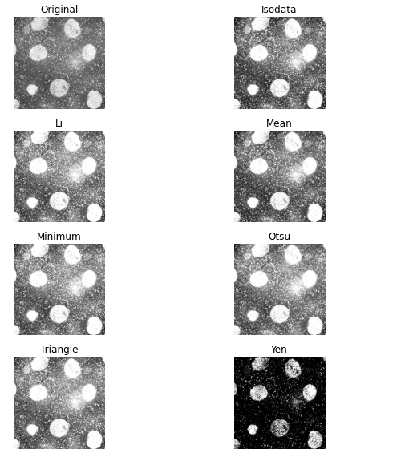
THERSHOLDING channel one
We tested out different thresholding techniques
OTSU : determined by minimizing intra-class intensity variance
ISODATA : k-means algorithm version for different number of clusters
LI : determined by minimizing the cross-entropy between the FG and the FG mean, and the BG and the BG mean

Slide 9
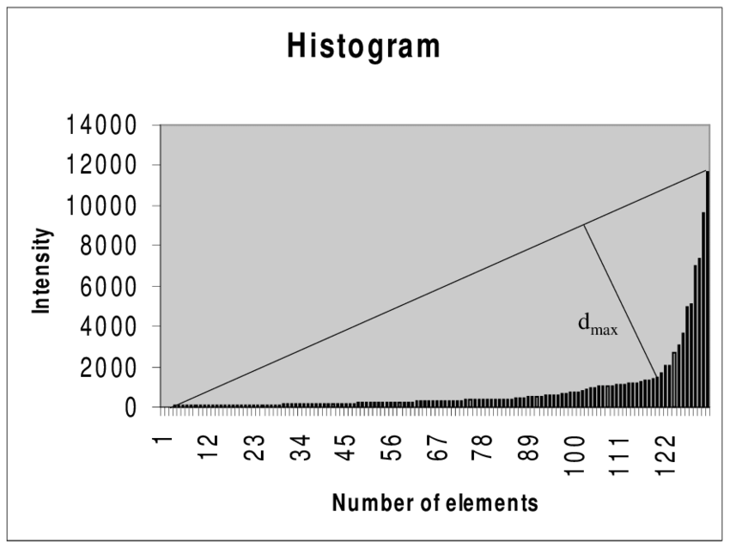
TRIANGLE thresholding
TRIANGLE thresholding constructs a line between the histogram peak and the farthest end of the histogram. The threshold is the point of maximum distance between the line and the histogram

Slide 10
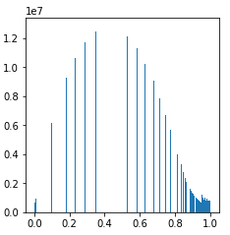
CHANNEL ONE segmentation (1) : Separate the bacteria from the background
BASED ON THE HISTOGRAM ABOVE, IT APPEARS THAT the background and foreground are separable using a single intensity threshold.

Slide 11
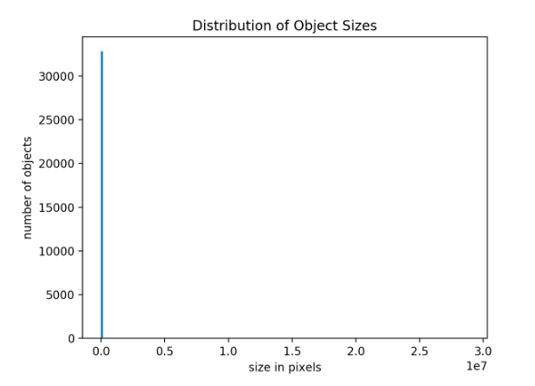
CHANNEL ONE segmentation (2) : Mark each potential bacterium with a unique label
ENV. 30 000 OBJECTS FOR NOW.

Slide 12
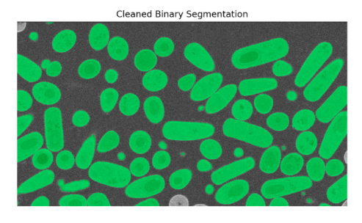
CHANNEL ONE segmentation (3) : Remove small islands and holes
Using binary morphological operations we remove small objects using the opening operation and fill small holes using the closing operation. The use of opening and closing by reconstruction maintains the boundary of the original objects.
ENV. 10 OBJECTS FOR NOW, BUT IT IS TRUE ?

Slide 13
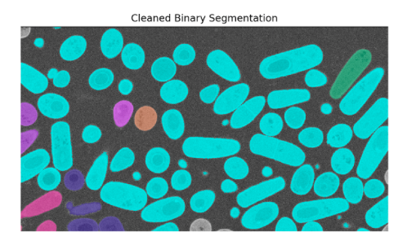
EXPLAINATION OF THE PROBLEM
each object is marked with a unique color. BUT SINCE THE CELLS TOUCH ONE ANOTHER DURING THE TIME, MANY OF THEM APPEARS AS CONNECTED AND WE NEED TO SEPARATE THE LABELLING

Slide 14
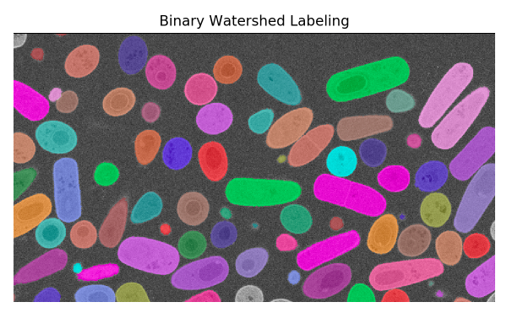
CHANNEL ONE segmentation (4) : seed based watersheds

Slide 15
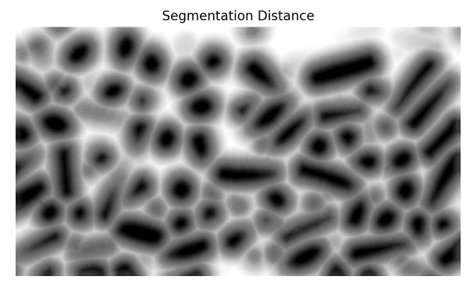
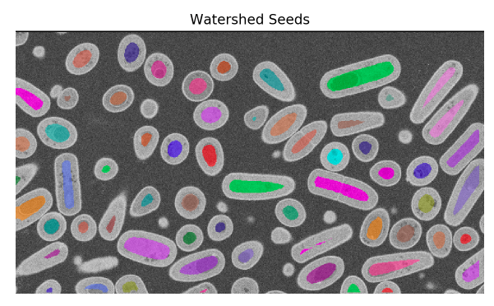
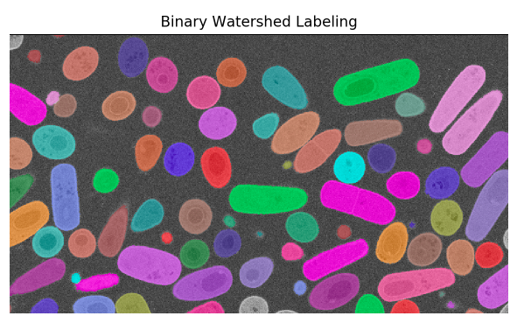
Seed based watershed segmentation
Euclidean distance transform
Relabel the seed objects
Morphological watershed from markers

Slide 16
https://docs.opencv.org/4.x/d3/db4/tutorial_py_watershed.html

Slide 17
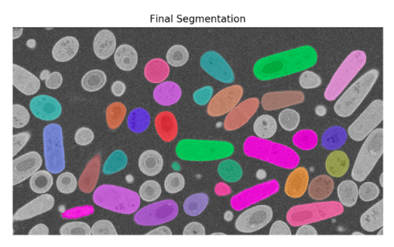
CHANNEL ONE segmentation (5) : Removal of objects touching the image boundary
We are not sure objects touching the image boundary are whole bacteria, so we remove them.

Slide 18
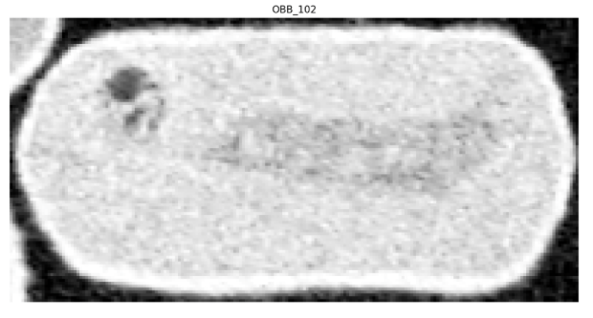
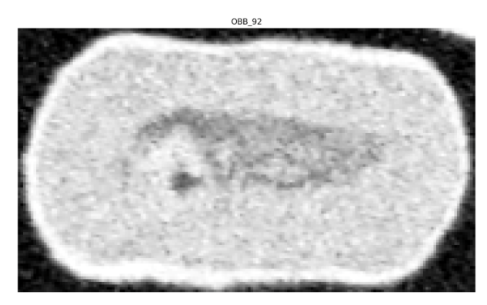
A few exemples of The segmented cells…

Slide 19

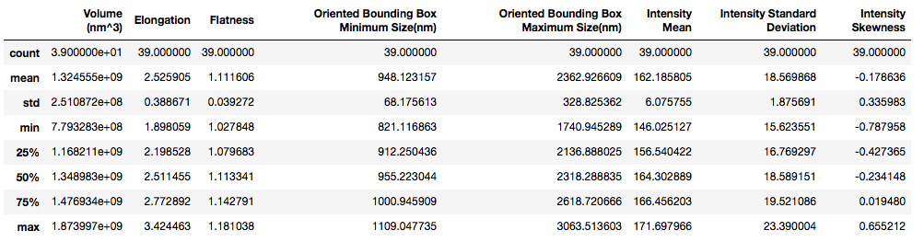
Some morphological properties about the segmented cells…
SOME STATISTICS AS :
MEAN VOLUME : 1.32E+9 NM^3
MEAN ELONGATION : 2.52
MEAN FLATNESS : 1.11
…

Slide 20
Poisson – Gaussian Noise
The noise distribution of images obtained by Spinning disk confocal microscopy can be analyzed using the Poisson and Gaussian mixture model.

Slide 21
OUR CHALLENGES TO COME …
DENOISING THE CHANNELS, ESPECIALLY THE SECOND ONE WHERE THE NOISE IS MORE IMPORTANT
characterization of the structure of tubular nuclear envelop invaginations in embryonic cells

Slide 22



Working environment

